Slide 1


Immigrant students in Europe suffer from lower grades: some social and scholastic features are the key to explain it
Giulia Bergonzoli, Ettore Busani, Sebastian Castellano, Lucia Gregorini
Applied Statistics – Politecnico di Milano 2022
Tutor: Chiara Masci

Slide 2

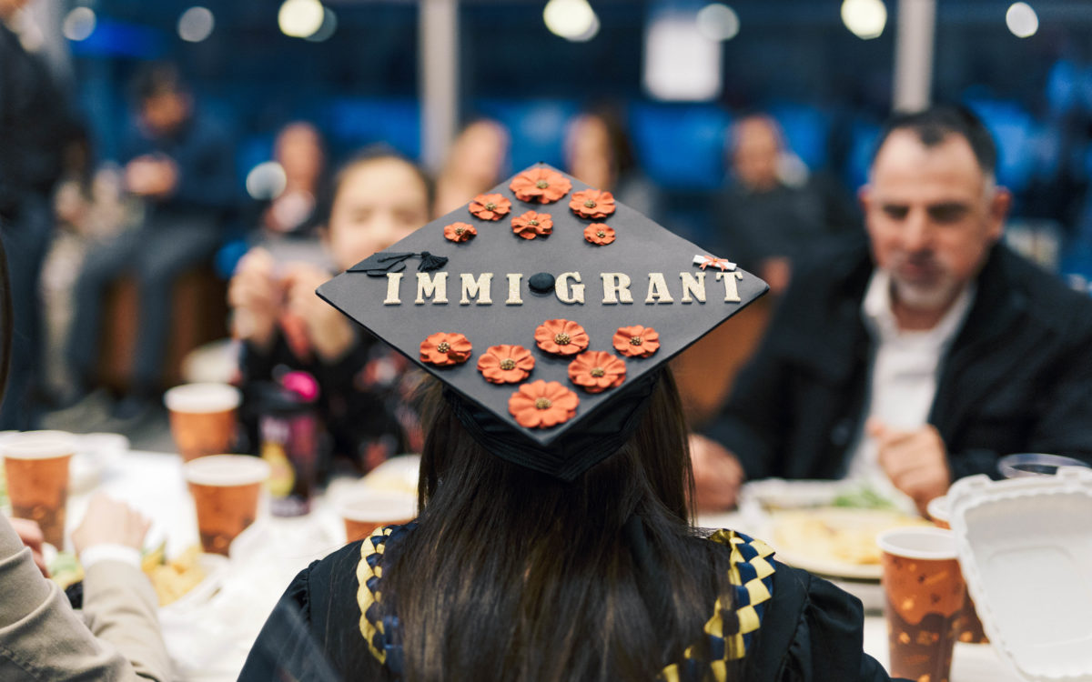
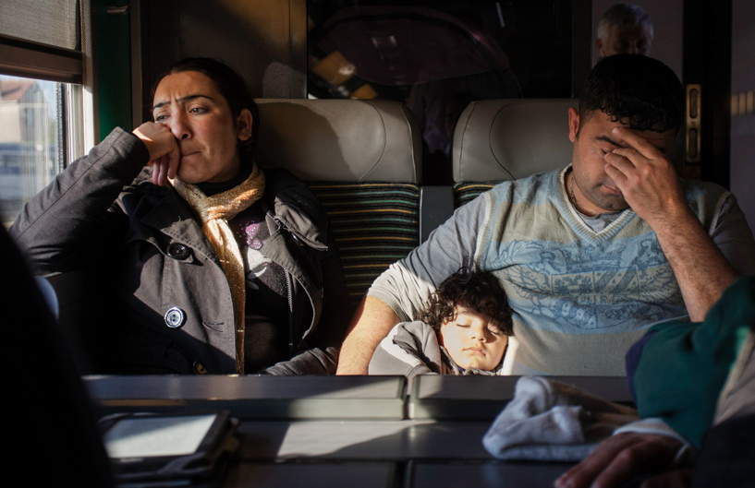

How do immigrant students face up when compared to native students?
Which features are most important when it comes to their scholastic success?
Which are the main differences in their scholastic, familiar, psychological characteristics?
How can we take example from the best European countries with respect to integration to help these students?

Slide 3

Come and have a look at what we found!

